Slide 1
Personal Software ProcessSM
for Engineers: Part II
Software Design II

Slide 2
Lecture Topics
The design process
UML and the PSP
Designing state machines
Verifying state machines

Slide 3
The Design Process
Software design is the creative process of producing a precise and effective solution to a poorly-defined problem.
The design process cannot be
  reduced to a routine procedure
  automated
  precisely controlled or predicted
The design process can be structured to
  separate the routine from the creative activities
  ensure that the design work is performed properly
  identify effective design tools and methods

Slide 4
Design as an Investment
Experienced programmers do not need to produce designs to write most small programs.
Designs are needed when small programs are to be used as parts of larger systems or when quality is critical.
Based on data from 8,100 PSP programs, programmers who produced designs
spent 53% more time than those who did not
wrote programs that were 46% smaller
Most programmers know how to write small programs. The critical skill is for developing large programs.

Slide 5
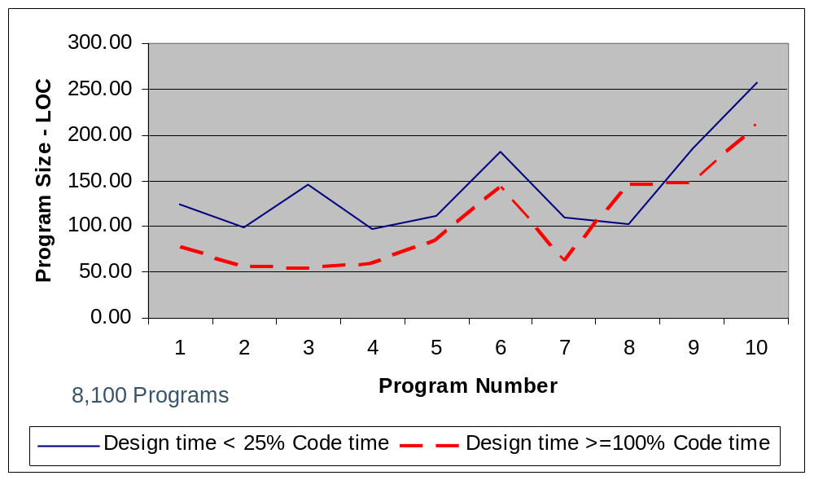
Designed Programs are Smaller
Notes:
See note for following slide.

Slide 6
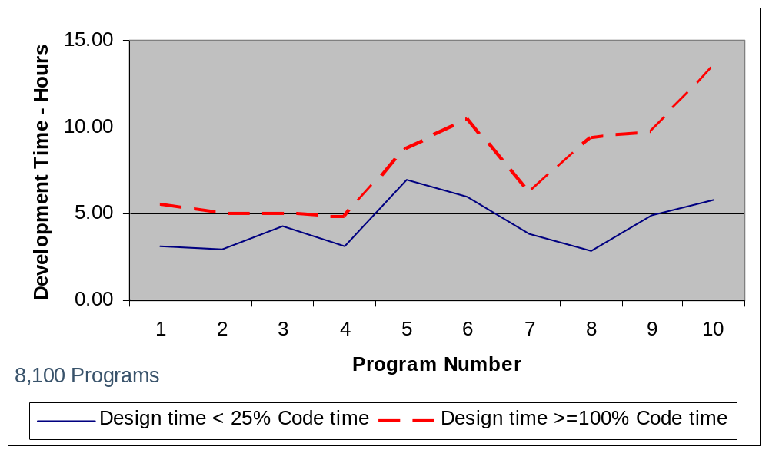
Design Takes Longer
Notes:
From the overall database of 8,100 programs written by 810 engineers in PSP training courses, the developers for 80 of the programs spent between 100 and 150% of coding time in design time. Those who spent more time were omitted because their excessive design time was often due to poor design practices or requirements misunderstandings. Of this same group, 151 had design times of less than 25% of coding time.
151 code intensive programs
80 design intensive programs
Average development time increase for design-intensive programs is 53%.

Slide 7
UML and the PSP -1
The Unified Modeling Language (UML) provides a graphical notation for describing software system behavior.
UML is based on notations developed by Booch, Rumbaugh, and Jacobson.
Standardization by the Object Management Group (OMG) has led to UML’s widespread acceptance.
Since UML has many formats and methods, users typically work with (small) UML subsets.

Slide 8
UML and the PSP -2
UML and the PSP templates are complementary.
  UML covers the logical and physical construction of a software system.
  The PSP templates focus on precise descriptions of interfaces and system and component behavior.
OCL (Object Constraint Language) is being developed to augment UML with a precise language for describing behavior. It is not yet widely used.
Notes:
In this lecture, we describe a subset of UML that (partially) satisfies the PSP design notation criteria.

Slide 9
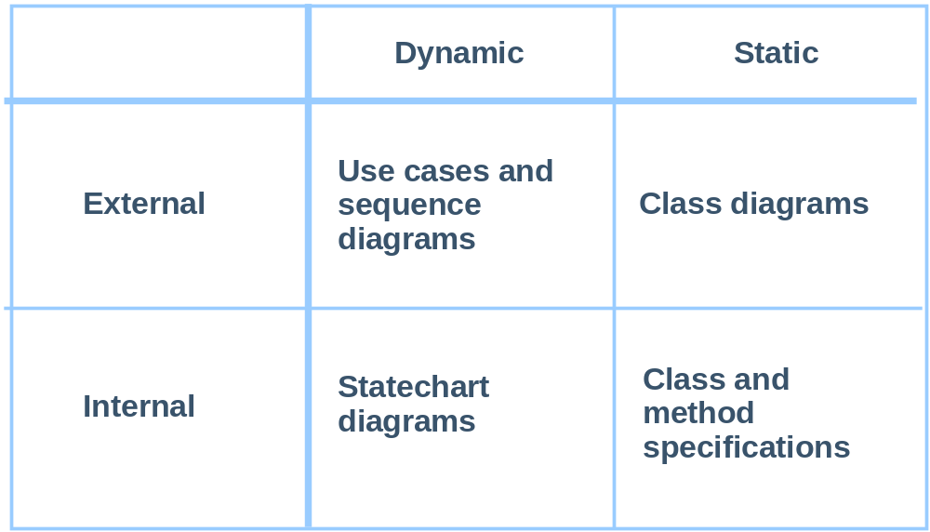
Mapping UML and PSP Views

Slide 10
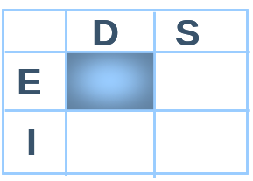
Use Cases
Use-case diagrams link actors (external agents) with use cases.
Each use case describes a unit of functionality and is documented in text. (UML does not define a format.)
A use case describes sequences of normal and abnormal interactions among actors and the system.
A use-case description is an external perspective, with the system viewed as a “black box.”
UML activity diagrams can also describe usage details.

Slide 11
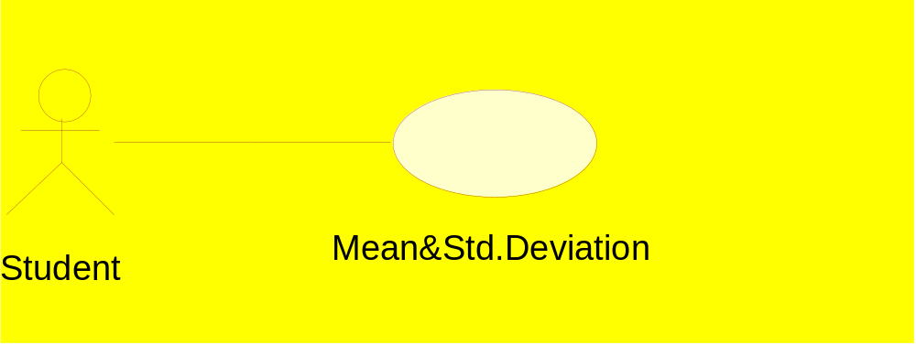
Use-Case Diagram
Notes:
This is a VERY simple (the simplest?) Use Case Diagram. The external actors (both people and other systems) are shown as stick figures linked by a relationship line with Use Case bubbles. Relationships between Use Cases can also be represented but good general advice is to keep Use Case diagram simple.

Slide 12
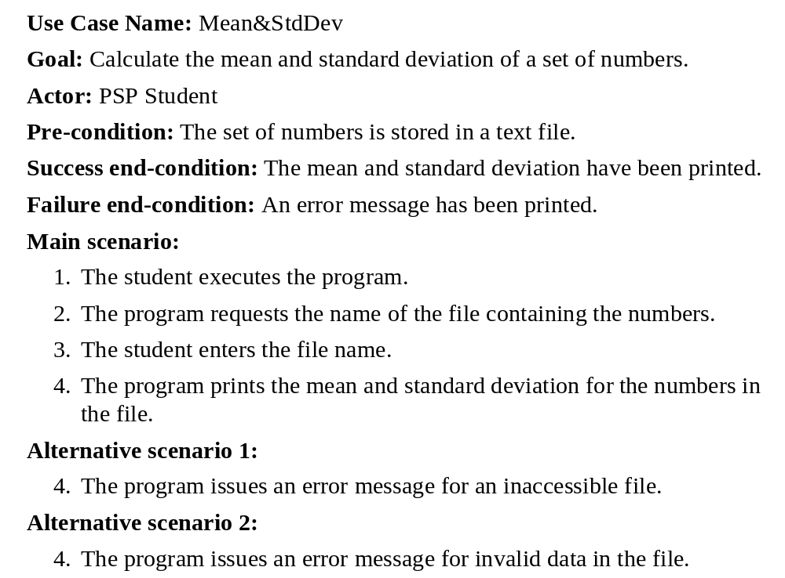
Use-Case Description Example
Notes:
The description is a necessary accompaniment to the Use Case diagram. This is just an example format (there are no accepted standards).
Note that this description contain information equivalent to the PSP Scenario template.

Slide 13
Sequence Diagrams
Sequence diagrams map the use case actions to the sequence of messages between objects and actors.
Sequence diagrams also specify the dynamic interactions among objects within a system.
Sequence diagrams describe the time ordering of the interactions.
UML also provides collaboration diagrams which describe the structural interconnections among objects.

Slide 14
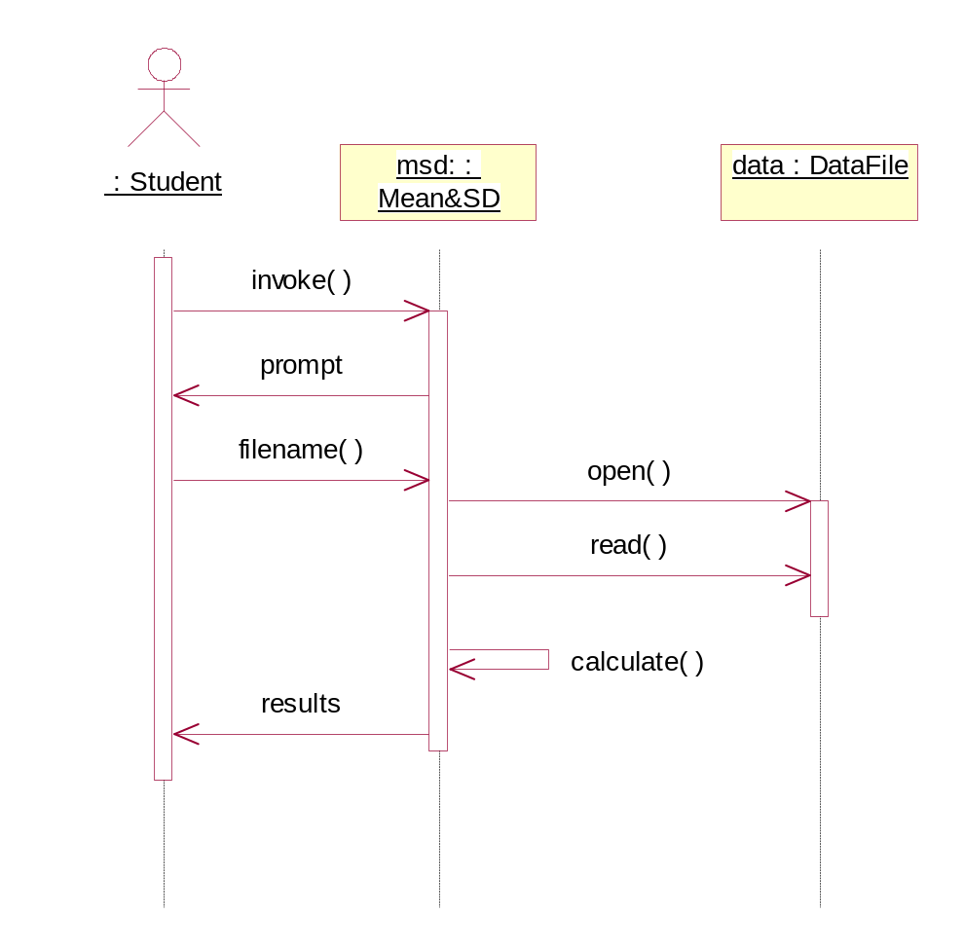
Sequence Diagram Example
Notes:
Objects are lists along the top (both external actors and component parts of the system). The vertical axis represents time with the dotted line below each object called its timeline. The horizontal arrows represent messages sent between objects and they are annotated with method names. "Calculate" is a message sent to the same object (self).

Slide 15
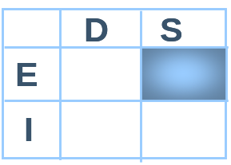
Class Diagrams
UML class diagrams describe the static relationships between a system and its classes, including associations and inheritance.
UML class diagrams also specify the methods and attributes of the class and the class external interfaces.

Slide 16
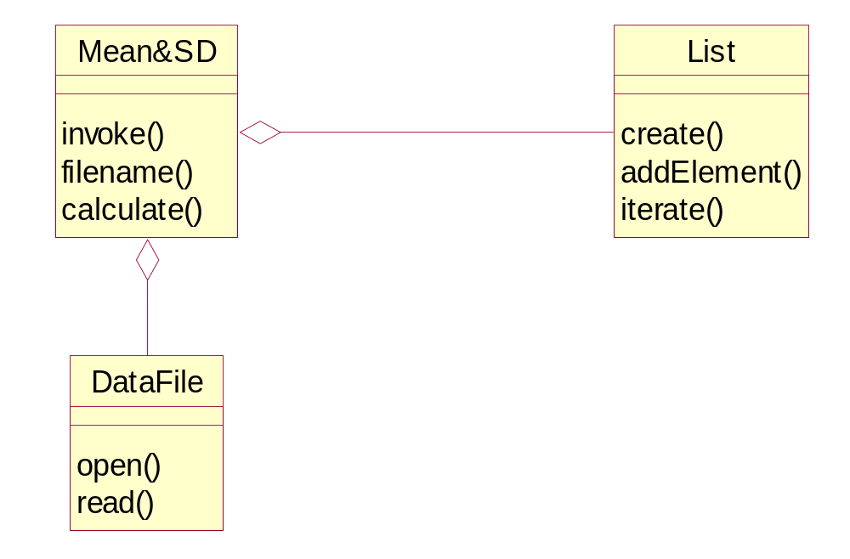
Class Diagram Example
Notes:
This simple diagram shows the relationship between three classes (aggregation, indicated by the diamond, meaning that an object of type "Mean&SD" has a components of type" DataFile" and another of type "List"). The names of methods are provided for each class. Attributes could be named in the middle part of the class box. Other association types and inheritance relationships as well as constraints on these relationships can be included in class diagrams.

Slide 17
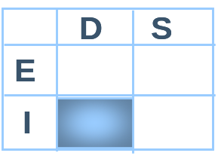
Statechart Diagrams
The UML statechart diagram describes all states that an object can have and the events that cause state transitions.
A statechart diagram identifies
  the states associated with an object
  its transitions (how an object changes state)
  its activities (what an object does in a state)

Slide 18
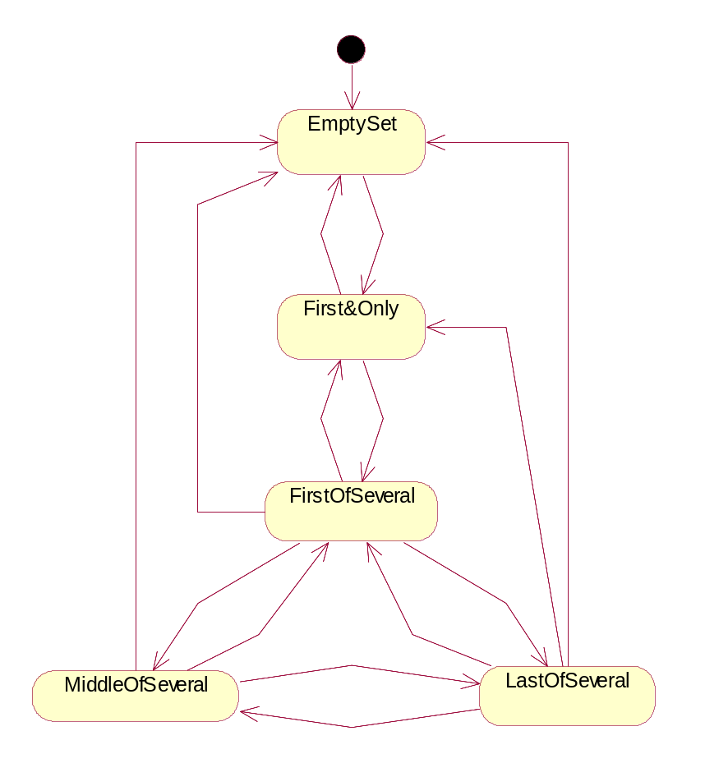
Statechart Diagram Example
Notes:
Here is the earlier diagram drawn using the UML statechart conventions. The black circle represents the initial or starting state. Details of the transitions (constraints and actions) should be added to each arc between states.

Slide 19
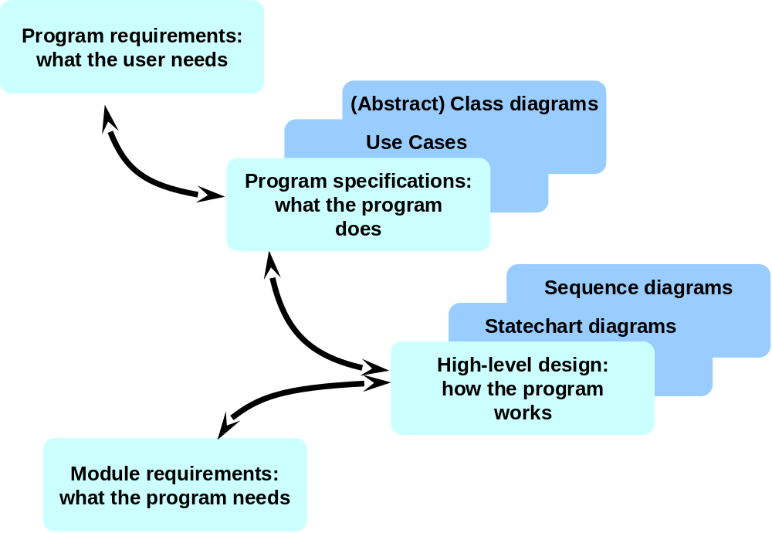
High-level Design Using UML

Slide 20
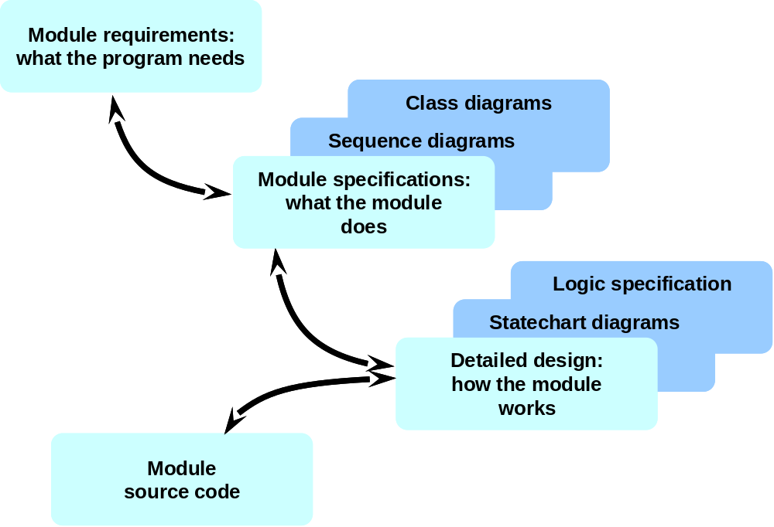
Detail-level Design Using UML

Slide 21
UML and the PSP Templates -1
The UML use case and sequence diagrams provide the same information as the PSP operational specification template.
UML class and sequence diagrams provide relationship and interaction information that is not captured in the PSP templates.
UML class diagrams record the method signature, but the behavioral specification should be documented with the PSP functional specification.

Slide 22
UML and the PSP Templates -2
The PSP logic specification template has no UML equivalent, so it should be used to record program logic.
The statechart and state diagram are equivalent.
UML does not have an equivalent to the state specification template.
In designing state machines with UML, record the finished design on the state specification template.

Slide 23
State Machines
A state machine has memory and its behavior depends on memory content.
All computers and many programs are state machines.
When module-sized programs contain state machines, the state-machine designs can be precisely defined and verified.
Without proper methods, it is rarely possible to understand or verify even modest-sized state machines.

Slide 24
An Example State Machine
The user login program is an example of a state machine.
The user is given several chances to provide a correct ID and password.
When a correct ID and password are provided, the user is logged in.
With too many ID or password errors, the login session is terminated.

Slide 25
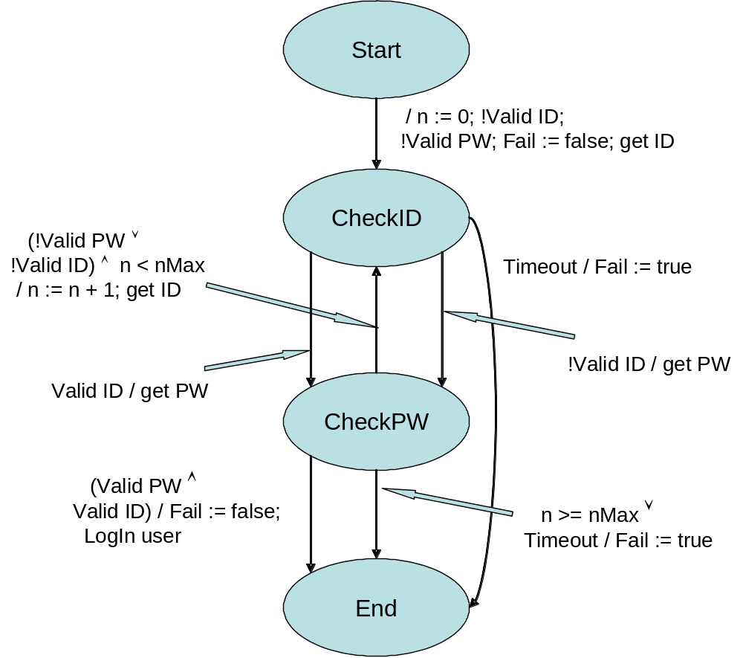
The “LogIn” State Diagram

Slide 26
Designing State Machines
The steps in designing state machines are as follows.
  Define the problem.
  Devise a solution strategy.
  Define the decisions that the program must make.
  Identify the information needed to make these decisions.
  Determine the states required to store this information.
  Specify the transitions among the states.

Slide 27
Solution Strategy
The solution strategy outlines the approach to solving the problem. It is usually sequential and often graphic.
An example strategy for LogIn is as follows.
  Check user ID.
  For security purposes, ask for PWs whether the ID is correct or not.
  If ID and password correct, LogIn the user.
  If password is incorrect, ask for IDs and passwords until they are both correct or the user makes too many errors.
  In all cases, if the user does not respond in time, timeout.

Slide 28
Decisions to Make
To implement this strategy, the program must make the following decisions.
  Do I request an ID and password?
  Do I LogIn the user?
  Do I timeout the user?
  Do I terminate the user session?

Slide 29
Information Required -1
The information required to make these decisions is as follows.
Do I request an ID?
  Is this a new user?
  Has the user submitted an incorrect password?
  Has the user submitted too many incorrect IDs or passwords?
Do I request a password?
  Has the user submitted an ID?

Slide 30
Information Required -2
Do I LogIn the user?
  Were the most recent ID and password correct?
Do I timeout the user?
  Has the user taken too long to answer a request?
Do I terminate the user session?
  Has the user been timed out?
  Has the user made too many ID or password errors?

Slide 31
System versus State Information
Some information results in the same action regardless of the state, and other information causes state-dependent actions.
Examples are
Timeout – regardless of state, session terminated
n > nMax – regardless of state, session terminated
In these cases, the system takes identical action regardless of the state.

Slide 32
Action Conditions
To determine the number or required states, consider the following questions and resulting actions.
1. Is this either a new user or one with an invalid password?
  Yes – get ID
  No – go to question 2
2. Has the user submitted an ID or a password?
  ID – get password
  Password – go to question 3
  Neither – terminate the session
3. Are the ID and password correct?
  Yes – log in the user and exit
  No – go to question 1
In every case, check if n > nMax or timeout.

Slide 33
Required States
For our example state machine, four states are needed.
  Start or new-user state
  CheckID
  CheckPW
  End

Slide 34
State Specification Template
The next state-machine design steps are to specify the
  transitions among the states
  actions taken with each transition
PSP uses the state specification template (SST) to define state-machine states, transitions, and actions.
With the SST, you can
  define state machine structure
  analyze the state machine design
  recognize mistakes and omissions

Slide 35
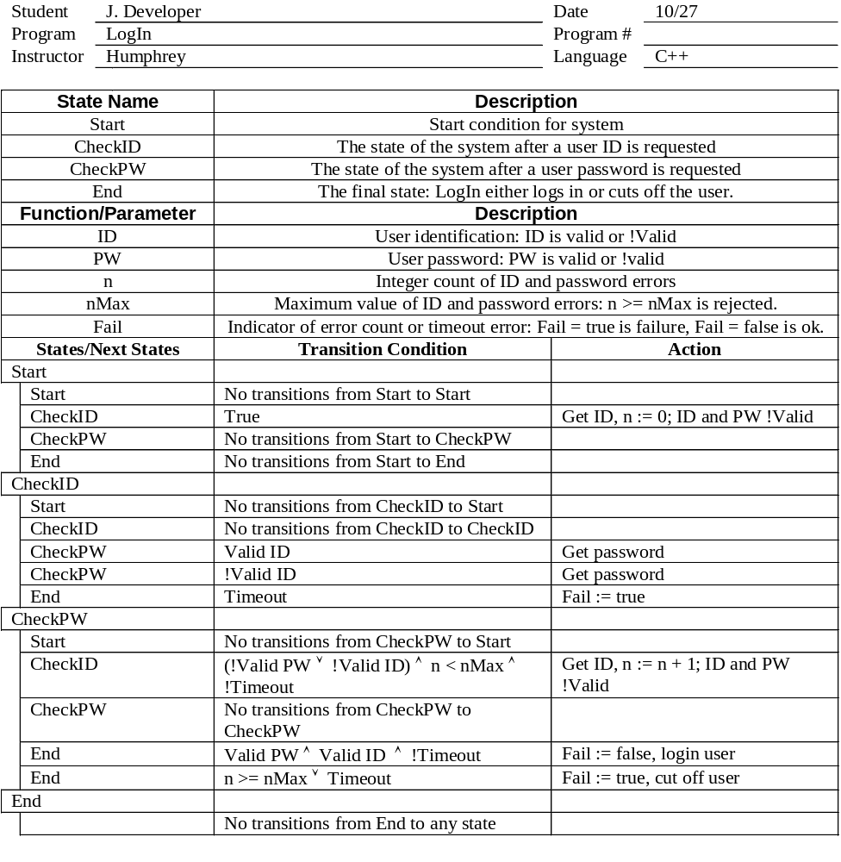
Example State Template

Slide 36
Transition Conditions
Most transition conditions are simple.
The CheckID to CheckPW transition occurs after getting an ID. It happens whether the ID is correct or incorrect
The CheckID to End transition occurs when there is a timeout, setting Fail := true.

Slide 37
Verifying State Machines
Specify all of the state machines in your programs.
  The trivial ones should be trivial to define.
  Seemingly simple state machines often are not simple.
  Without precise specifications, complex state machines are almost always defective.
Check for completeness and consistency.
  The set of transition conditions from any given state must be complete and orthogonal.
  The actions on each transition must be defined.

Slide 38
A Proper State Machine
In a proper state machine, the state transitions are all complete and orthogonal.
  Complete Transitions: a transition is defined for every possible situation.
  Orthogonal Transitions: none of the transitions have overlapping conditions.
With a proper state machine
  a next state is defined for every possible condition
  the designated next state is unique

Slide 39
State-machine Verification
The state-machine verification steps are as follows.
  Check to ensure that the state machine has no hidden traps or loops.
  Check that the set of all transitions from every state is complete and orthogonal.
In addition to verifying state-machine correctness, also ensure that the program performs its intended functions.

Slide 40
Hidden Traps or Loops -1
Check for hidden traps and loops by
  constructing the state template
  constructing a state machine diagram
  determining if any exit states are unreachable from any other states
If any state cannot reach an exit state, this is not
a proper state machine.
If the state machine does not have an exit state, ensure that it contains no endless loops.

Slide 41
Hidden Traps or Loops -2
For example, consider the LogIn state machine.
  There are four states: Start, CheckID, CheckPW, and End.
  There is a direct or indirect path from each state to End.
One possible loop is between CheckID and CheckPW.
Since n is increased by one for every cycle, n will ultimately exceed nMax and cause a transition to end.
Therefore, this state machine has no hidden traps or loops.

Slide 42
State Transitions -1
For LogIn, the transition from Start is always to CheckID.
From CheckID, the transitions are complete and orthogonal with no overlaps. The transition conditions are
  Start: impossible
  Valid ID: to CheckPW
  !Valid ID: to CheckPW
  Timeout: to End

Slide 43
State Transitions -2
From CheckPW, the transitions are as follows.
  Start: impossible
  CheckID: !Valid ID or !Valid PW
  End: Valid PW and Valid ID
  End: n >= nMax or Timeout
Verifying the completeness and orthogonality of these conditions requires analysis.
A truth table is a useful way to make such an analyses.

Slide 44
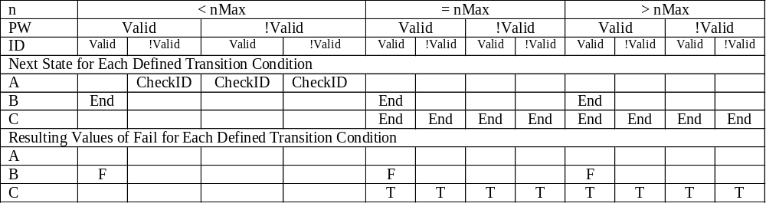
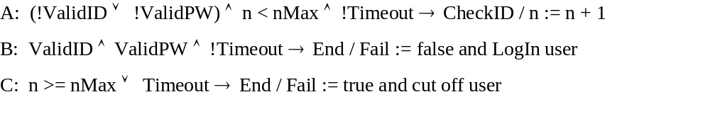
State Transitions -3
Transitions from CheckPW are as follows.
The A, B, and C conditions are as follows.

Slide 45
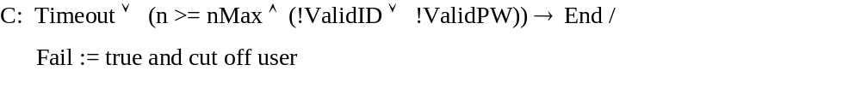
State Transitions -4
The End transition has two indeterminate cases.
n = nMax and valid PW and valid ID
n > nMax and valid PW and valid ID
These cases are possible, depending on the implementation and should be prevented.
This can be done by changing the C equation

Slide 46
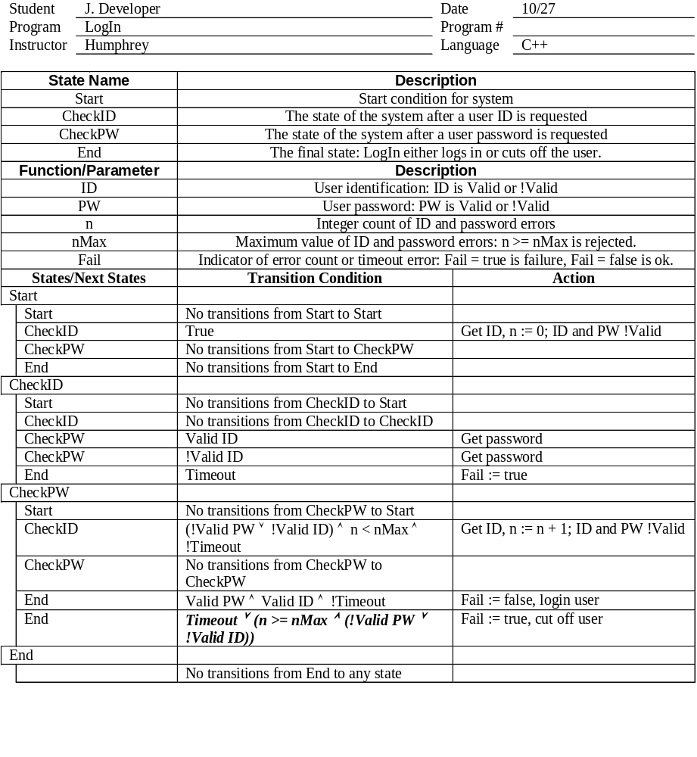
Corrected LogIn State Template

Slide 47

Verification Exercise
Using the methods just discussed, verify the stopwatch state-machine design in the state template in the handout.
Pair up again and take 20 minutes to verify the correctness of the state template for the stopwatch state machine.
20 minutes

Slide 48
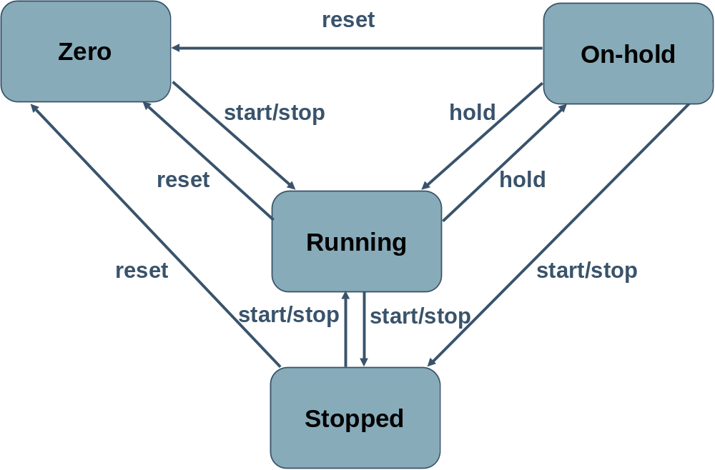
Exercise: State Diagram

Slide 49
Exercise Comments
This stopwatch state machine design is incomplete.
The SST does not specify what happens when you press
  hold in zero
  reset in zero
  hold when stopped
Also, are transitions possible from Zero to On-hold or Stopped, or from Stopped to On-hold?
When these transitions and actions are properly defined, the state machine will be also.

Slide 50
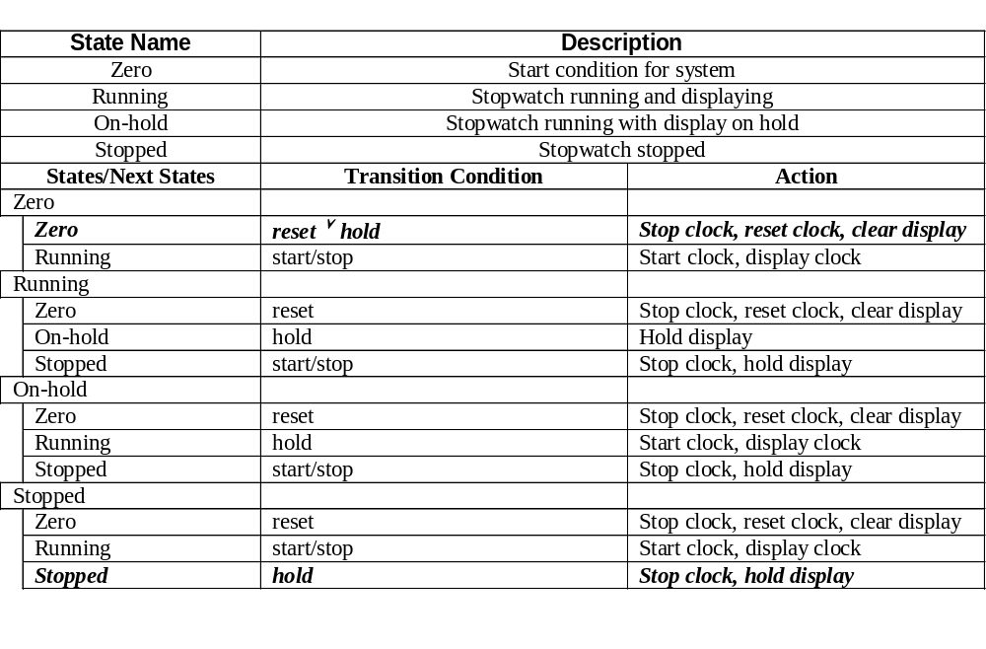
Corrected State Template

Slide 51
Messages to Remember
A precise design notation helps you to produce clear and correct designs.
UML provides design information that is not in the PSP templates and the templates have design information that is not shown with current UML methods.
Since state machines are complex, state-machine implementations often contain errors.
Identify the state machines in your programs and use the state template to design and verify them.
State machine defects are exceedingly difficult to find and fix in test.

